Slide 1
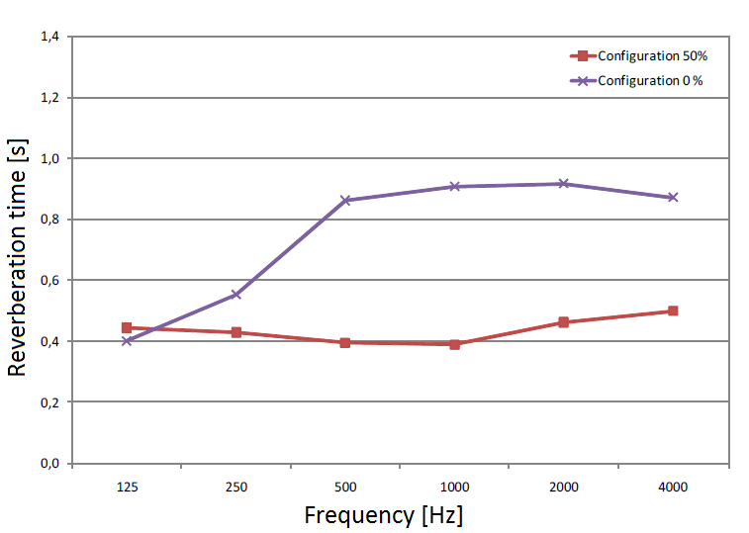
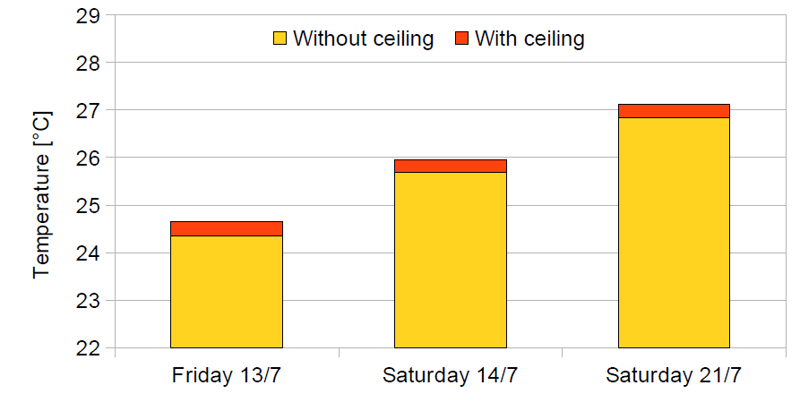
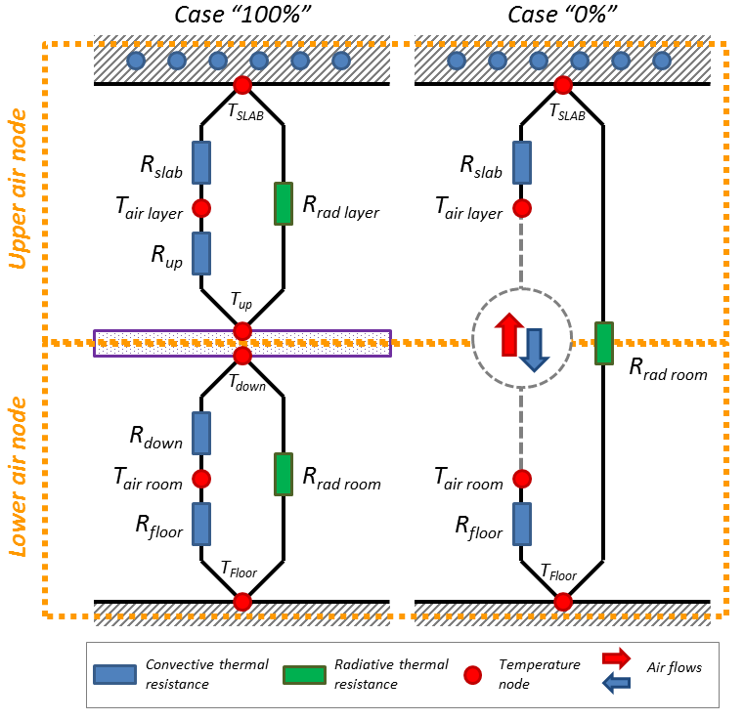
Measure and model of free hanging sound absorbers impact on thermal comfort
W14142
Pierre LOMBARD
Saint Gobain Recherche
39 Quai Lucien Lefranc - 93303 Aubervilliers, FR
pierre.lombard@saint-gobain.com
Context
Reducing temperature peaks in buildings is possible by using the thermal mass of the concrete slab. In Thermally Activated Building System (TABS), heat is discharged by flowing cold water into pipes embedded into the concrete.
In such building, occupants exchange with the cooled ceiling by convection (~40%) and by radiation (~60%).
► The larger the surface of exposed concrete, the better the exchanges with the ceiling
But a large surface of concrete will degrade acoustic comfort. To restore comfort, a solution is to use Free Hanging Sound absorbers.
► The larger the surface of sound absorbers, the better the acoustic comfort.
Is it possible to combine acoustic and thermal comfort in TABS buildings?
Quantification
We measured during few days in summer 2012 air and
operative temperature in two rooms of the TABS
building « WOOPA » (Lyon, FR).
Acoustic comfort
► Covering 50% of the ceiling with sound absorbers reduces the reverberation time (500-2000 Hz) from 0.9 sec to 0.4 sec.
Thermal comfort:
► Covering 50% of the ceiling with sound absorbers leads to an average increase of +0.3 K of the felt temperature.
► Due to the difficulty of comparing room behavior in real buildings, these measurements has to be repeated.
+0,28
+0,3
+0,26
Variation of reverberation time in a room covered with 50% of sound absorbers
Increase of operative temperature computed on three different days in a room covered with 50% of sound absorbers
Thermal model
TRNSys 17 is a software modeling the dynamic thermal behavior of buildings. Unfortunately,
it is not able to model properly sound absorbers. We thus propose here a thermal model
which will be implemented into a new plug-in.
Principle:
Room is divided into two TRNSys thermal zones separated by a layer which have the thermal properties of sound absorbers. For a given ceiling coverage ratios, heat flux and surface temperatures are computed using classical relations for convective, radiative transfers [1] and injected into TRNSys. Vertical air flows are estimated with the approach proposed by Vera [3] & Zhigang [2].
Main hypothesis (compatible with TRNSys model):
Each air node represents a volume of air perfectly mixed, characterized by only one temperature
The gap between and the disposition of sound absorbers does not modify thermal transfers. Only the total surface covered by sound absorbers is considered
Vera’s work for opening covering <20 % of ceiling surface may be extended to other ceiling openings areas.
Discussion
Conclusion and next steps
Literature [4, 5] confirms that sound absorbers have a limited impact on thermal comfort (increase of air temperature < 1 K) or energy efficiency (reduction of TABS cooling capacity < 20%). Even if sound absorbers reduce thermal exchanges by radiation, they do not fully cover the ceiling and still allow convection. But sound absorbers disposition seems to influence thermal exchanges.
Thermal model predicts an increase of operative temperature of 0.33 K for 50% coverage ratio but seems to largely under estimate impact of higher coverage ratios.
First measurements show that sound absorbers have a limited impact on thermal comfort in TABS buildings (+0.3 K for 50% coverage) while they improve acoustic comfort. To help building designers to evaluate the impact of sound absorbers, we propose a first thermal model based on a two-node approach and implemented into a plug in for the TRNSys thermal software.
In order to confirm the first measurements made in the WOOPA tower as well to validate the plug in, a new set of experiments at both lab scale and in a real building are on-going. Last, the sensitivity of the model to its input parameters will be evaluated
. This work was supported by the Saint Gobain company. We sincerely thanks P. Chigot and Y. Le-Muet, from Saint Gobain Ecophon
[1] F. Incropera et al.; Fundamentals of Heat and Mass Transfer. Wiley, 2007.
[2] Li Zhigang. Characteristics of Buoyancy Driven Natural Ventilation through Horizontal Openings. PhD thesis, Aalborg University, 2007.
[3] S. Vera. Interzonal Air and Moisture Transport through Large Horizontal Openings: An Integrated Experimental and Numerical Study. PhD thesis, Concordia University, 2009.
[4] H. Drotleff et al.; Integrated sound absorption in thermally activated concrete ceilings - acoustic and thermal effectiveness of sound-absorber strips spaced at intervals. Bauphysik, 33:274–286, 2011.
[5] R. Hoseggen et al.; The effect of suspended ceilings on energy performance and thermal comfort. Energy and Buildings, 41:234–245, 2009

